Slide 1
General Practice Facts & Stats
Recruitment & Retention

Slide 2
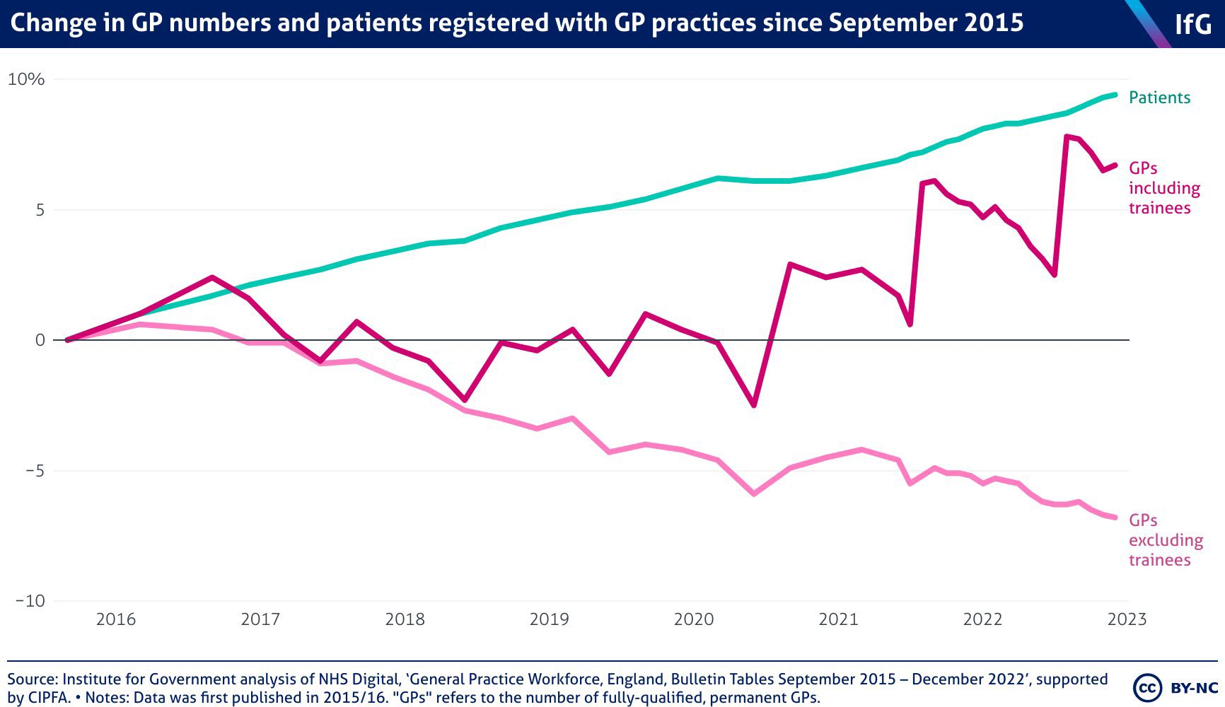
Government numbers often now quote GP trainees as part of ‘GP’ numbers.
They are not fully qualified and therefore this artificially boosts the picture of the workforce.
As training is so different from the true job then many leave after qualifying.
The change in GP numbers and patients registered with GP Practices Since 2015

Slide 3
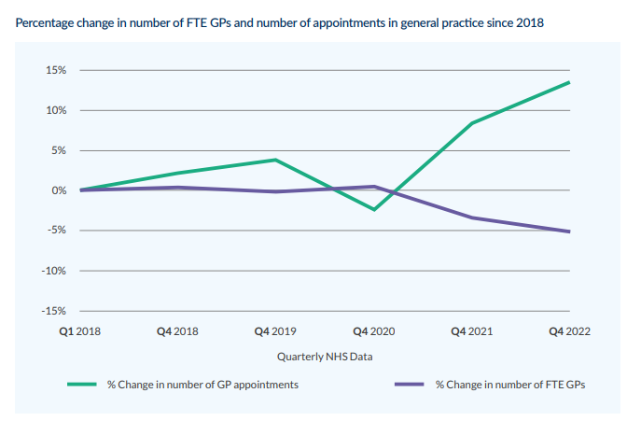
Percentage change in number of FTE GPs and number of appointments in general practice since 2018
As you can see the trend is for a reduction in workforce – however despite this appointment numbers are rising.
Ultimately we are stretching a smaller workforce thinner. We are at a point where this increase is not sustainable and means practitioners working at unsafe levels.
Source: RCGP Fit for the Future, A new plan for GPs and their patients

Slide 4
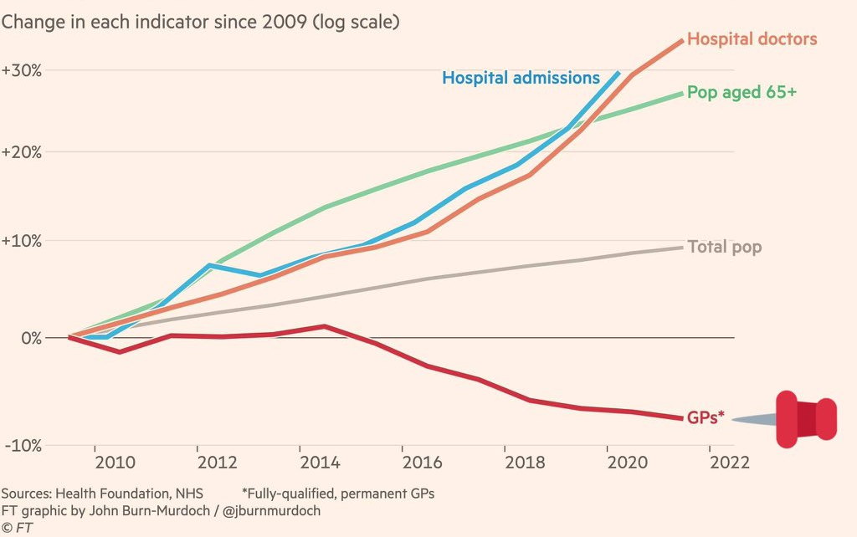
The number of NHS hospital doctors has grown broadly in line with demand for hospital care, but GP numbers have fallen over the last decade
Consultants have increased exponentially. This was needed.
Despite a drive to carry out more care in the community and a rising elderly and medically complex population there has been no similar investment in increasing the GP workforce to keep pace with demands and manage their ongoing care.

Slide 5
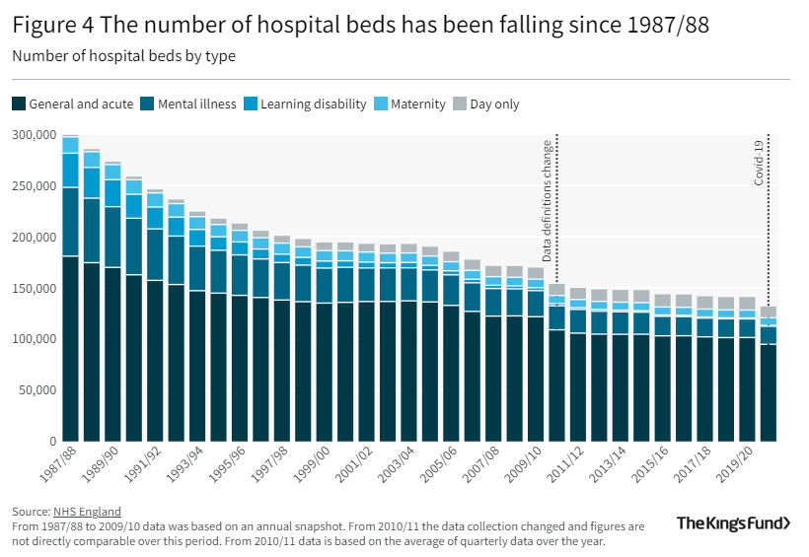
Number of hospital beds falling
The reduction in beds causes huge pressures for hospitals.
It also means that sicker patients come out into the community and require ongoing care – this relies on the vastly understaffed community and GP teams
https://www.kingsfund.org.uk/publications/nhs-hospital-bed-numbers
https://twitter.com/DrSteveTaylor/status/1640624462172225539?s=20

Slide 6
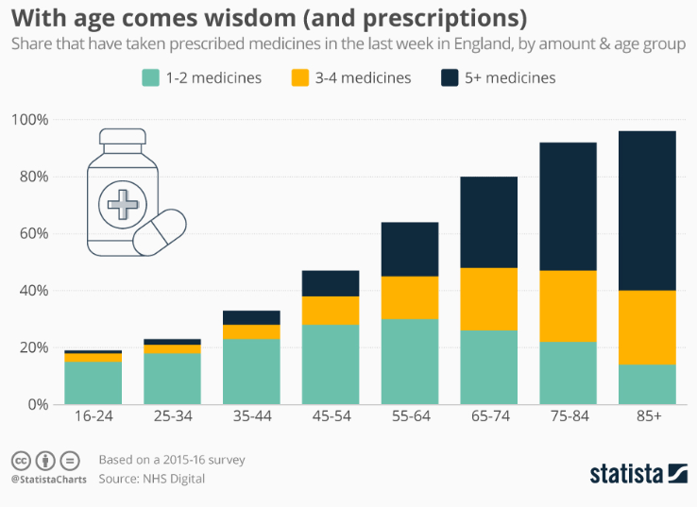
With age comes wisdom (and prescriptions)
This shows a little of the complexity of our population.
Every medication requires reviewing at least annually. They may also require monitoring (blood tests etc) which require call and recall, organisation, appointments and time to review the results.
With some patients on over 30 regular medications the risk of symptoms of side effects and interactions exponentially increases.
https://www.statista.com/chart/20056/prescription-medicine-by-age-group-england/
https://twitter.com/DrSteveTaylor/status/1640624462172225539?s=20

Slide 7
Impact on Stockbridge Surgery
At this surgery we are seeing evidence of all these trends highlighted by Wessex Local Medical Committee:
Reduced numbers of qualified GPs meaning it is harder to fill vacancies and find cover for sickness, maternity and holidays. This causes pressure on our team who have to work longer hours.
Rising demand for appointments
Lack of hospital beds meaning patients are discharged sooner requiring more follow-up, and sometimes readmission to hospital
The average age of our population is increasing meaning more patients with long-term health conditions who require more care.
These slides are available on our website, stockbridgesurgery.co.uk in the news section
if you want the opportunity to look at them in more detail.

